Slide 1
TIPS FOR GETTING YOUR HSIP PROJECT FUNDED
GVMC Technical Committee
May 2, 2018

Slide 2
Pamela R. Blazo, P.E.
MDOT Local Agency Programs Safety Engineer
Notes:
-Administer the federal safety money (aka HSIP) on the local system
-More fatalities occur on the local road network
-60% in 2016

Slide 3
2020 Safety Program ($15M)
The Call Letter is expected in early May
3 month window for applications
Will be split between HRRR and general HSIP

Slide 4
Eligible for Federal safety funds?
Who?
Which Roads?
Any Act 51 agency
83 county road commissions
274 cities
259 incorporated villages
Any non-MDOT roadway open to the general public
Regardless of National Functional Classification
Does not have to be on the Fed-Aid network
Regardless of ADT

Slide 5
Construction Funding
80/20 (Fed/Local)
90/10
Addresses a K/A crash
Systemic
$600,000 Max Federal per project
ROW and CE are not eligible

Slide 6
Preliminary Engineering Funding
5% Report
90/10 Fed/Local
Traffic Signal Optimization
80/20 Fed/Local
$5,000 max per signal location
Road Safety Audit (RSA)
80/20 Fed/Local
$15,000 max per RSA
Local Safety Initiative (LSI)
50/50 Fed/Local

Slide 7
Read the Call Letter
Notes:
*Info/Requirements are modified each year. Know the HRRR application differences……TOR for ALL projects

Slide 8
Cover Letter
Location Map
Form 1627
Cost Estimate
Time of Return (TOR) and/or Highway Safety Manual (HSM) analysis
UD-10s (crash reports)
6 Required Documents
Notes:
*Points may be subtracted in there is missing information

Slide 9
Financial Goals (from FY 2019)

Slide 10
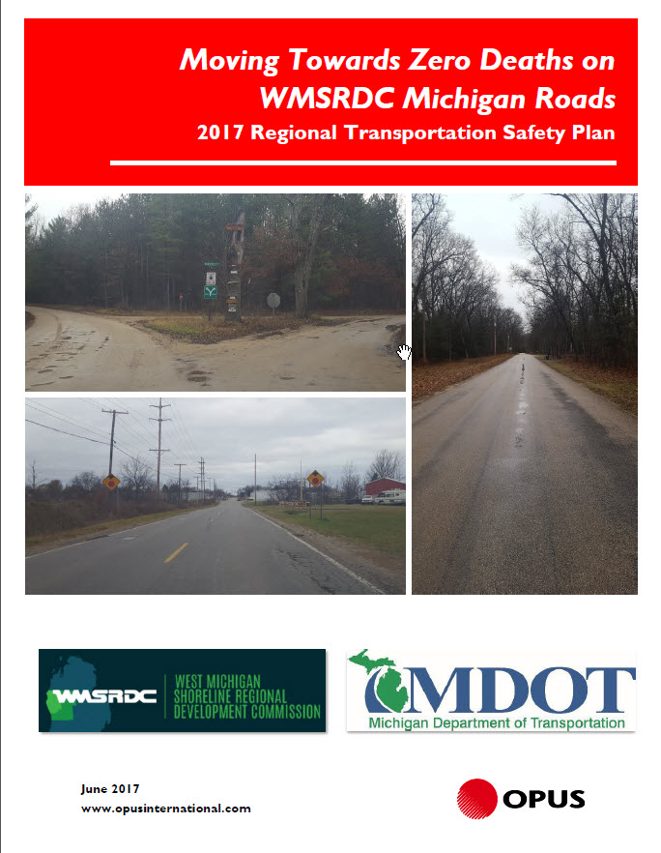
Local (Regional) Road Safety Plans

Slide 11
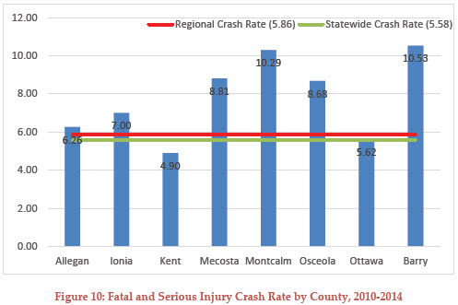
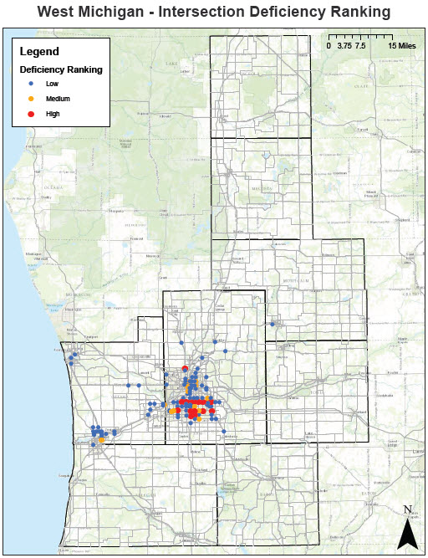
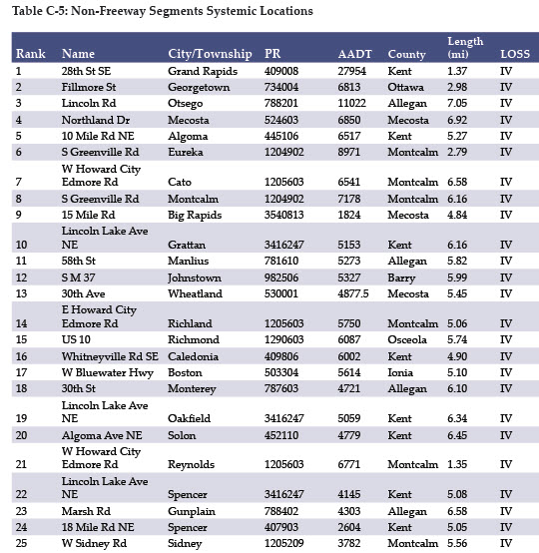
Prioritization Examples
Notes:
Plans include county specific data, lists of the top priority locations. Some contain heatmaps.

Slide 12
GVMC RTSP

Slide 13
Appendices B and C

Slide 14
Appendix B – Safety Analysis Maps

Slide 15
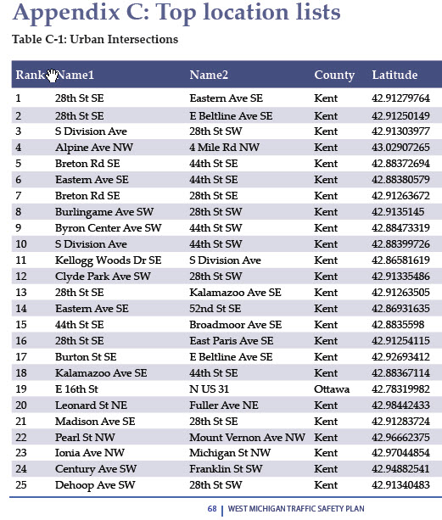
Appendix C – Top Locations

Slide 16
2 Main Project Types for HSIP funding
Spot Location
Systemic

Slide 17
Low-Cost Systemic Application
New 1 page streamlined application
$1.5M Financial Goal in the general HSIP
$250,000 max. per project

Slide 18
Cover Letter
Location Map
Form 1627
Cost Estimate
Time of Return (TOR) and/or Highway Safety Manual (HSM) analysis
UD-10s (crash reports)
6 Required Documents
Notes:
*Points may be subtracted in there is missing information

Slide 19
Application Cover Letter Sheet
1 Page Excel Form
Pick your project type
State your project length
State project location (can include a separate map)
Enter your project cost
2 Required Documents
Notes:
There will only be a handful of proven safety countermeasures to choose from. Each choice will have its own design requirements.
*Horizontal Curve Signing
*Rumble Strips
*Edgelines
*Reflective Post Sheeting on Stop Signs and/or Dual Stop/Stop Ahead signs

Slide 20
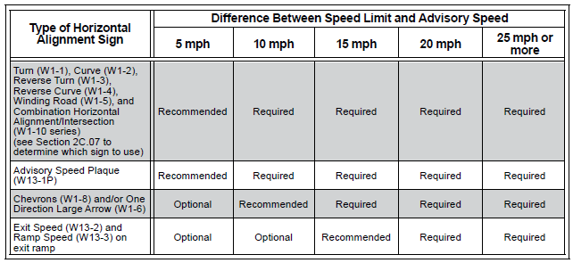
Horizontal Curve Delineation
2011 MMUTCD, Table 2C-5
Recommended vs Required
Notes:
Recommend Chevrons compared to one single target arrow. Provides a visual cue regarding the sharpness of the curve as their spacing is related to the advisory speed and curve radius. The criteria for determining the advisory speed changed with the 2011 MMUTCD. Your agencies should be verifying/updating curve signing with all 3R/4R projects.

Slide 21
Horizontal Curve Delineation

Slide 22
Horizontal Curve Delineation – Advance Curve Sign
Notes:
Tells driver which direction the roadway curves – left or right

Slide 23
Horizontal Curve Delineation – Advisory Speed Sign
Notes:
Recommended operating speed to traverse the curve. Many of these signs are outdated as they were not revised when the 2011 MMUTCD came out. The older signs typically display a speed 5-10 mph below what the new advisory speed is. These ‘low’ speed signs are often ignored by the drivers.

Slide 24
Horizontal Curve Delineation – Target Arrow Sign
Notes:
Reaffirms to driver which direction the roadway curves – left or right

Slide 25
Horizontal Curve Delineation – Chevron Signs
Notes:
Chevrons not only reaffirm which direction the road curves but also the sharpness of the curve

Slide 26
Horizontal Curve Delineation – Reflective Post Sheeting
Notes:
‘Lollipops’ increase the visibility of the sign assembly.

Slide 27
Focused / Targeted Projects
Focus on the observed crash types and crash risks
Don’t ask for money for non-safety related items
This Photo by Unknown Author is licensed under CC BY-SA
Notes:
YES, you can submit projects without any documented crashes…..we will talk about the HSM later in the presentation.
*Majority of crashes along corridor located in curves……….don’t repave entire 1 mile corridor…….focus on the curve locations (delineation, superelevation correction, curve flattening, HFST)
*Shield an existing culvert……don’t replace/upsize the culvert
*Flatten slopes and remove GR rather than replacing GR
**Not intended for maintenance

Slide 28
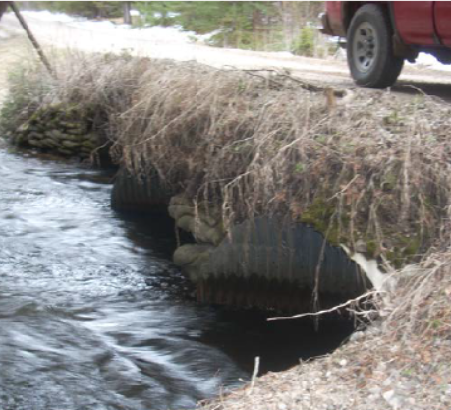
Provide site pictures
Notes:
Not required, but extremely helpful. The applications are scored based on your included information….a site visit is not conducted.

Slide 29
Obtain your best TOR
Each crash can only be applied to one CRF
Crashes vs Injuries
3-5 years of data
Always download the latest version

Slide 30
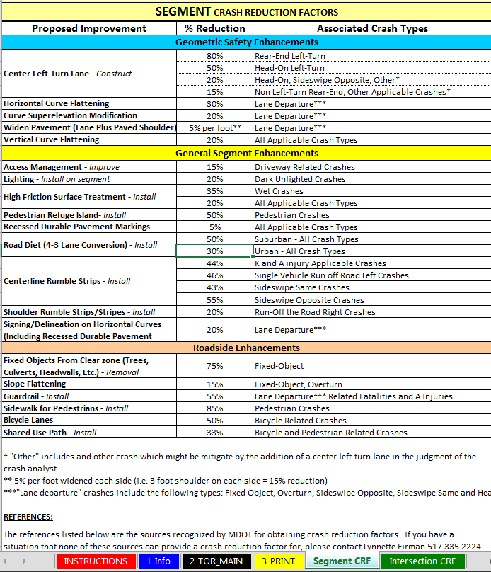
Notes:
Approved CRF are provided in the spreadsheet.
*If using a different CRF, provide a printout from the CMF Clearinghouse……….pre-approval is recommended

Slide 31
Pick the best applicable CRF for the specific crash
Widen the paved shoulders from 1’ to 4’
15% CRF for lane departure crashes
Install centerline rumble strips
46% CRF Single Vehicle Run off Road Left Crash
43% CRF Sideswipe Same Crash
55% CRF Sideswipe Opposite and HD-ON Crashes
Remove trees within the ROW
75% CRF
Notes:
Example project:
Pick the best CRF for your observed crash. Don’t just place everything under one CRF, for example the 15% for paving the shoulder.

Slide 32
Crash #1
Vehicle runs off the road to the right and overturns

Slide 33
Example Project
Widen the paved shoulders from 1’ to 4’
15% CRF for lane departure crashes
Install centerline rumble strips
46% CRF Single Vehicle Run off Road Left Crash
43% CRF Sideswipe Same Crash
55% CRF Sideswipe Opposite and HD-ON Crashes
Remove trees within the ROW
75% CRF
Notes:
Crash #1: Vehicle runs off the road to the right and overturns
Crash #2: Vehicle crosses the centerline, runs off the road to the left, and comes to rest in the ditch
Crash #3: Vehicle runs off the road to the left and strikes a tree
Crash #4: Vehicle #1 is stopped waiting to turn left and is struck from behind
Crash #5: Car vs Deer

Slide 34
Crash #2
Vehicle crosses the centerline, runs off the road to the left, and comes to rest in the ditch

Slide 35
Example Project
Widen the paved shoulders from 1’ to 4’
15% CRF for lane departure crashes
Install centerline rumble strips
46% CRF Single Vehicle Run off Road Left Crash
43% CRF Sideswipe Same Crash
55% CRF Sideswipe Opposite and HD-ON Crashes
Remove trees within the ROW
75% CRF
Notes:
Don’t place it in the 15% for paved shoulders if there is a better CRF that is applicable

Slide 36
Crash #3
Vehicle runs off the road to the left and strikes a tree

Slide 37
Example Project
Widen the paved shoulders from 1’ to 4’
15% CRF for lane departure crashes
Install centerline rumble strips
46% CRF Single Vehicle Run off Road Left Crash
43% CRF Sideswipe Same Crash
55% CRF Sideswipe Opposite and HD-ON Crashes
Remove trees within the ROW
75% CRF

Slide 38
Crash #4
Vehicle #1 is stopped waiting to turn left and is struck from behind

Slide 39
Example Project
Widen the paved shoulders from 1’ to 4’
15% CRF for lane departure crashes
Install centerline rumble strips
46% CRF Single Vehicle Run off Road Left Crash
43% CRF Sideswipe Same Crash
55% CRF Sideswipe Opposite and HD-ON Crashes
Remove trees within the ROW
75% CRF
Notes:
Do not include crashes that do not have an applicable CRF based on your project type

Slide 40
Crash #5
Vehicle #1 crosses the centerline and strikes vehicle #2 head-on

Slide 41
Example Project
Widen the paved shoulders from 1’ to 4’
15% CRF for lane departure crashes
Install centerline rumble strips
46% CRF Single Vehicle Run off Road Left Crash
43% CRF Sideswipe Same Crash
55% CRF Sideswipe Opposite and HD-ON Crashes
Remove trees within the ROW
75% CRF
Notes:
Do not include crashes that do not have an applicable CRF based on your project type

Slide 42
Crash #6
Car vs Deer
Notes:
If they actually hit the deer.
-If the UD-10 just states ‘I swerved to avoid a deer’, include the UD-10/crash. Likely not true and just what they told the cop as justification for running off the road.

Slide 43
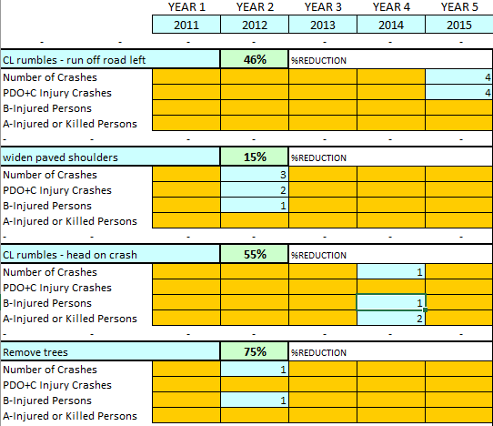
TOR - Crashes vs Injuries
If there are no K/A/B injuries, the number of crashes should equal the number of PDO+C Injury Crashes
May have a combination
One crash may have multiple injured persons
Not just the most injured person
You will not always have an entry in the second line

Slide 44
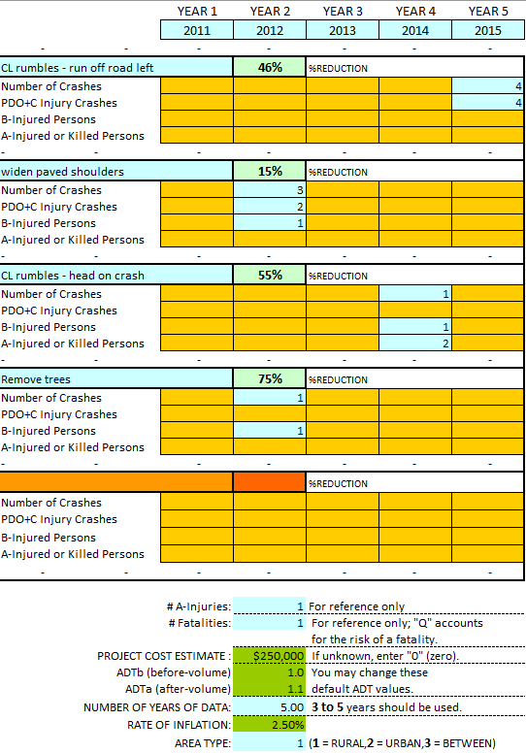
Number of years?
TOR = 2.08
5 years
Notes:
You do not have to always use 5 years of data, however you can not skip years.
-Recommend submitting the remaining UD-10s for unused years as ‘supplemental’….clearly define them as supplemental
*In our case we had crashes in 2012, 2014 and 2015. Can’t ‘skip’ 2013………….use 4 years

Slide 45
Number of years?
TOR = 1.67
4 years
Notes:
You do not have to always use 5 years of data, however you can not skip years.
*In our case we had crashes in 2012, 2014 and 2015. Can’t ‘skip’ 2013………….use 4 years

Slide 46
High Risk Rural Roads
2x Funding Chances
Rural (based on urban area census boundary)
NFC = Major Collector / Minor Collector / Local
≥ 1 K or A
Notes:
*Projects not selected in HRRR rolled into HSIP automatically
*K/A must be addressed by proposed fix

Slide 47
The Elusive Bonus Points

Slide 48
GVMC RTSP

Slide 49
Use the HSM

Slide 50
Highway Safety Manual (HSM) Analysis
Used for 2 purposes related to the CFP
Excess Expected crashes
Reduction in predicted crash frequency
Notes:
Fear not…it’s easy(ish)

Slide 51
Highway Safety Manual (HSM) Analysis
Not directly interchangeable with the TOR spreadsheet
CMFs vs CRFs
All crashes regardless of type (including animal)
Notes:
*HSM…….predicted, expected
*TOR….observed, crash type specific crashes

Slide 52
Highway Safety Manual (HSM) Analysis
Rural 2-Lane Segments Tab
Notes:
*Need to attach either the excel file or a pdf of the tab(s) used to your application.

Slide 53
Highway Safety Manual (HSM) Analysis
Rural 2-Lane Segments Tab

Slide 54
Highway Safety Manual (HSM) Analysis
Rural 2-Lane Segments Tab
Notes:
-Some CMFs available in the dropdown list
-Additional CMF can be entered in the numeric column
**Be sure to explain what this CMF is for and where you obtained the value.
-Calibration Factor is automatically shown.

Slide 55
Highway Safety Manual (HSM) Analysis
Rural 2-Lane Segments Tab
Notes:
*Need to attach either the excel file or a pdf of the tab(s) used to your application.

Slide 56
Highway Safety Manual (HSM) Analysis
Excess Expected Crashes
How is the site in question performing in the ‘existing’ condition?
Notes:
-Only full years of observed crashes (Jan-Dec) can be used; partial years not compatible with the calibration factors.
-If you do not have any observed crashes, that’s OK. That’s where the 2nd part of this comes into play.

Slide 57
Highway Safety Manual (HSM) Analysis
Reduction in predicted FI crashes = 0.51 crashes/year
Reduction in predicted PDO crashes = 4.2 crashes/year
These are converted to a Time of Return (TOR)
Notes:
-Crash costs were established in the HSM using 2001 dollars along with a process of updating those costs to current dollars.
-Adjusted to current year values using the Consumers Price Index (CPI) and the Employment Cost Index (ECI)
**Get credit for the better of the 2 TORs when scoring.

Slide 58
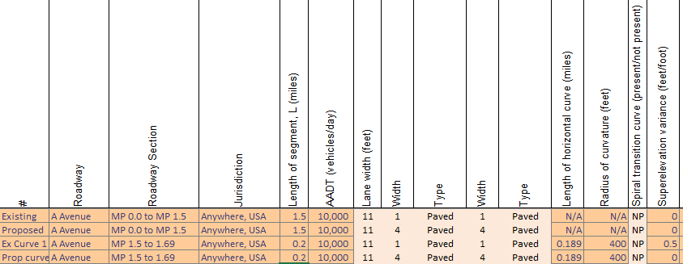
Highway Safety Manual (HSM) Analysis
Need to enter curves as their own segment
If there are intersections, enter them on the appropriate intersection related tab

Slide 59
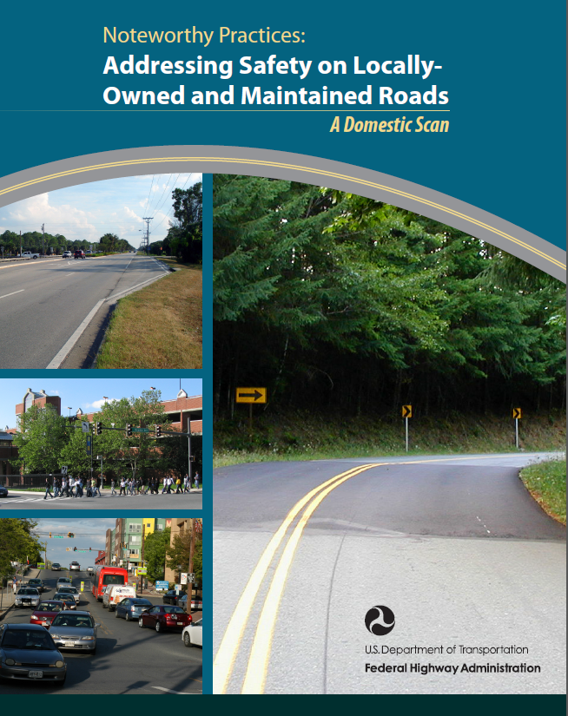
Local Safety Initiative (LSI)
Free service
Level of detail tailored to each agency
Recommended countermeasures
PE money
http://safety.fhwa.dot.gov/local_rural/training/fhwasa10027/fhwasa10027.pdf
Notes:
-Began in 2004
-available to counties, cities, villages, tribes (>400 cities/villages)
-Recognized as a national best practice by FHWA

Slide 60
Agency Partnering
This Photo by Unknown Author is licensed under CC BY-NC-SA

Slide 61
Leverage Multiple Funding Sources
Allows us to stretch the HSIP funds further

Slide 62
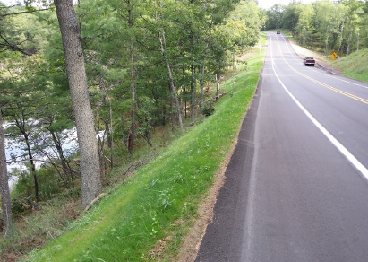
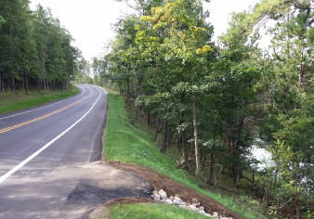
Steep Foreslopes
Notes:
Notice the new pavement!

Slide 63
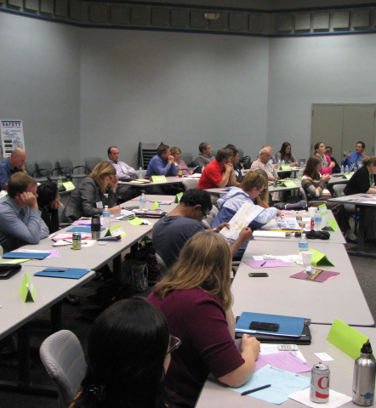
Upcoming Safety Peer Exchange
FHWA sponsored in-state peer exchange
Learn from your peers
Teach your peers

Slide 64
QUESTIONS
Pamela R. Blazo, P.E.
Local Agency Program
Safety Engineer
Michigan DOT
BlazoP@mighigan.gov

